Slide 1
UNIT 3

Slide 2
Learning with Trees
We are now going to consider a rather different approach to machine learning, starting with one of the most common and powerful data structures in the whole of computer science:
The binary tree :the computational cost of making the tree is fairly low, but the cost of using it is even lower: O(logN), where N is the number of datapoints.
This is important for machine learning, since querying the trained algorithm should be as fast as possible since it happens more often, and the result is often wanted immediately.
This is sufficient to make trees seem attractive for machine learning and they are easy to understand.

Slide 3
Decision Trees
Decision Tree is a Supervised learning technique that can be used for both classification and Regression problems, but mostly it is preferred for solving Classification problems.
It is a tree-structured classifier, where
internal nodes represent the features of a dataset,
branches represent the decision rules and
each leaf node represents the outcome.
In a Decision tree, there are two nodes, which are the Decision Node and Leaf Node.

Slide 4
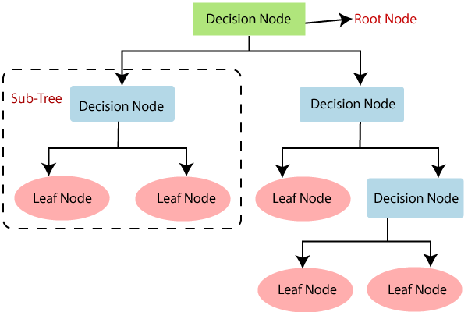
Decision nodes are used to make any decision and have multiple branches, whereas Leaf nodes are the output of those decisions and do not contain any further branches.
The decisions or the test are performed on the basis of features of the given dataset.

Slide 5
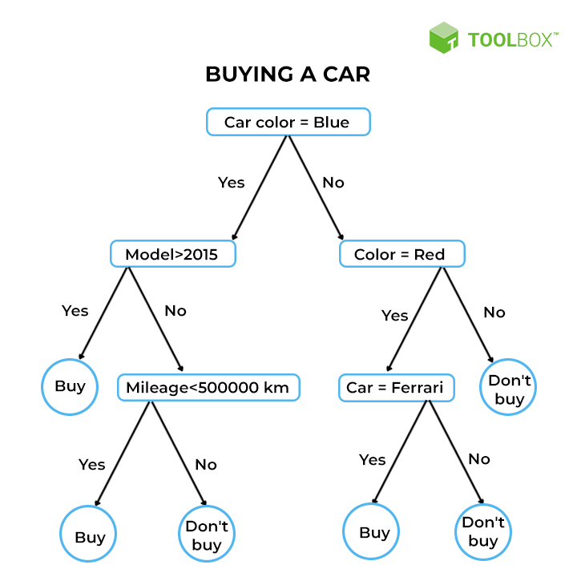

Slide 6
The idea of a decision tree is that we break classification down into a set of choices about each feature in turn, starting at the root (base) of the tree and progressing down to the leaves, where we receive the classification decision.
The trees are very easy to understand, and can even be turned into a set of if-then rules, suitable for use in a rule induction system.
In terms of optimisation and search, decision trees use a greedy heuristic to perform search, evaluating the possible options at the current stage of learning and making the one that seems optimal at that point.
This works well a surprisingly large amount of the time.

Slide 7
Using Decision Tree
As a student it can be difficult to decide what to do in the evening.
There are four things that you actually quite enjoy doing, or have to do:
going to the pub,
watching TV,
going to a party, or
even (gasp) studying.
The choice is sometimes made for you—if you have an assignment due the next day, then you need to study, if you are feeling lazy then the pub isn’t for you, and if there isn’t a party then you can’t go to it. You are looking for a nice algorithm that will let you decide what to do each evening without having to think about it every night.

Slide 8
Each evening you start at the top (root) of the tree and check whether any of your friends know about a party that night. If there is one, then you need to go, regardless.
Only if there is not a party do you worry about whether or not you have an assignment deadline coming up. If there is a crucial deadline, then you have to study, but if there is nothing that is urgent for the next few days, you think about how you feel.
A sudden burst of energy might make you study, but otherwise you’ll be slumped in front of the TV indulging your favorite movie or series rather than studying.
Of course, near the start of the semester when there are no assignments to do, and you are feeling rich, you’ll be in the pub.

Slide 9
One of the reasons that decision trees are popular is that we can turn them into a set of logical disjunctions (if ... then rules) that then go into program code very simply—the first part of the tree above can be turned into:
• if there is a party then go to it
• if there is not a party and you have an urgent deadline then study
• etc.

Slide 10
CONSTRUCTING DECISION TREES

Slide 11
Classification by Decision Tree Induction
Decision tree
A flow-chart-like tree structure
Internal node denotes a test on an attribute
Branch represents an outcome of the test
Leaf nodes represent class labels or class distribution
Decision tree generation consists of two phases
Tree construction
At start, all the training examples are at the root
Partition examples recursively based on selected attributes
Tree pruning
Identify and remove branches (nodes) that reflect noise or outliers
Use of decision tree: Classifying an unknown sample
Test the attribute values of the sample against the decision tree
11

Slide 12
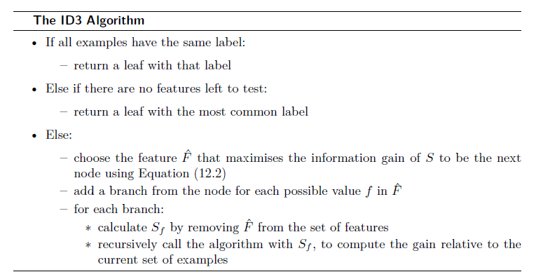
ID3 (Iterative Dichotomiser 3)

Slide 13
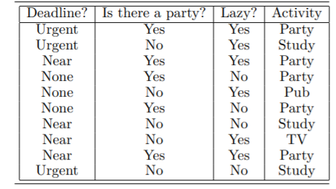
When we want to construct the decision tree to decide what to do in the evening

Slide 14
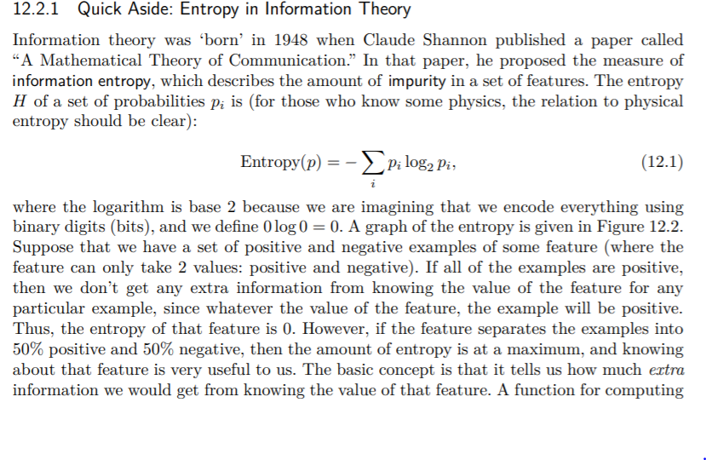

Slide 15
In the Decision Tree, the major challenge is the identification of the attribute for the root node at each level. This process is known as attribute selection measure (ASM). We have two popular attribute selection measures:
Information Gain
Gini Index
1. Information Gain:
When we use a node in a decision tree to partition the training instances into smaller subsets the entropy changes. Information gain is a measure of this change in entropy.

Slide 16
Gini index:
Gini Index is a metric to measure how often a randomly chosen element would be incorrectly identified.
It means an attribute with a lower Gini index should be preferred.
Sklearn supports “Gini” criteria for Gini Index and by default, it takes “gini” value.
The Formula for the calculation of the Gini Index is given below.

Slide 17
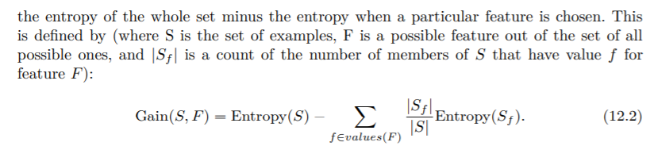
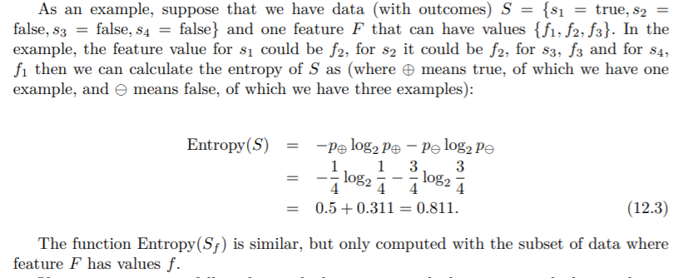

Slide 18
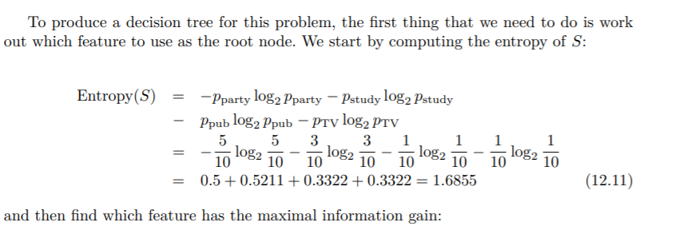

Slide 19
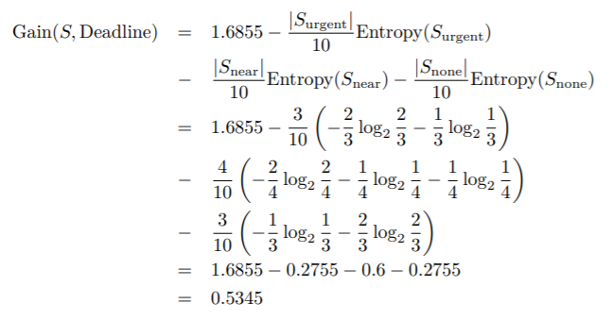

Slide 20
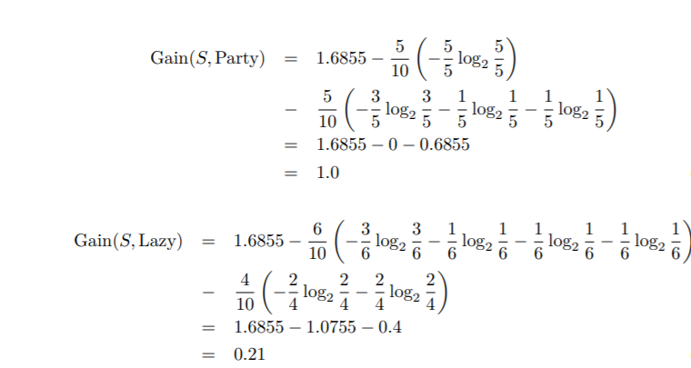

Slide 21
Therefore, the root node will be the party feature, which has two feature values (‘yes’ and ‘no’), so it will have two branches coming out of it (see Figure 12.6).
When we look at the ‘yes’ branch, we see that in all five cases where there was a party we went to it, so we just put a leaf node there, saying ‘party’.
For the ‘no’ branch, out of the five cases there are three different outcomes, so now we need to choose another feature. The five cases we are looking at are:

Slide 22
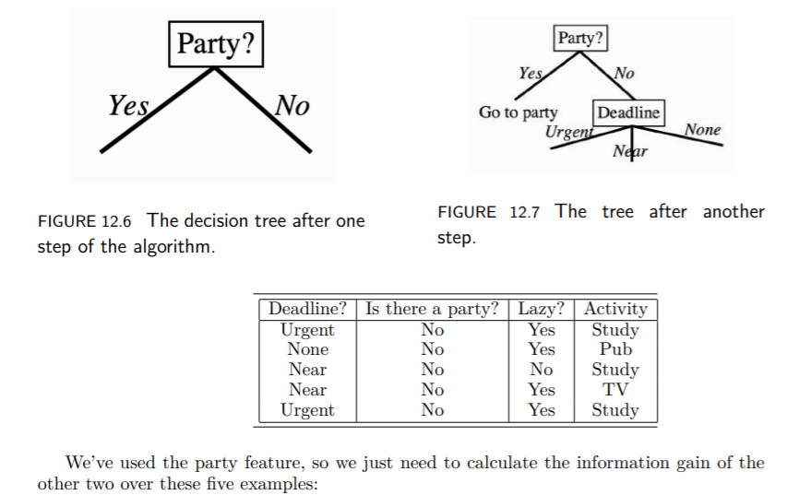

Slide 23
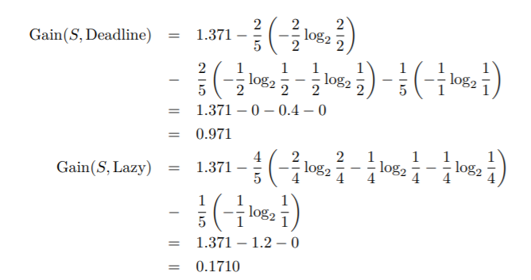

Slide 24
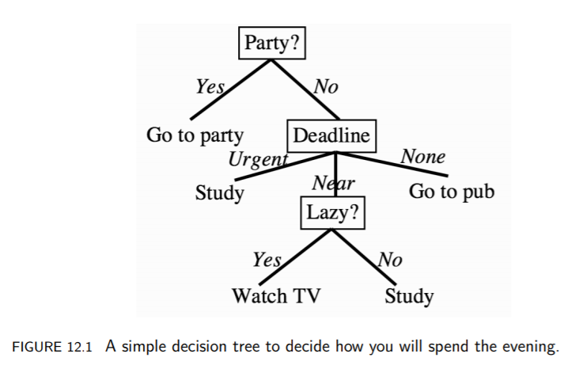

Slide 25
CART (Classification And Regression Tree)
CART is a variation of the decision tree algorithm. It can handle both classification and regression tasks.
Scikit-Learn uses the Classification And Regression Tree (CART) algorithm to train Decision Trees (also called “growing” trees).
CART was first produced by Leo Breiman, Jerome Friedman, Richard Olshen, and Charles Stone in 1984.
The entropy that was used in ID3 as the information measure is not the only way to pick features. Another possibility is something known as the Gini impurity.

Slide 26
CART (Classification And Regression Tree)
Gini Index/Gini Impurity:
The Gini index is a metric for the classification tasks in CART. It stores the sum of squared probabilities of each class. It computes the degree of probability of a specific variable that is wrongly being classified when chosen randomly and a variation of the Gini coefficient. It works on categorical variables, provides outcomes either “successful” or “failure” and hence conducts binary splitting only.
The degree of the Gini index varies from 0 to 1,
Where 0 depicts that all the elements are allied to a certain class, or only one class exists there.
The Gini index of value 1 signifies that all the elements are randomly distributed across various classes, and
A value of 0.5 denotes the elements are uniformly distributed into some classes.

Slide 27


CART (Classification And Regression Tree)
Gini Index/Gini Impurity:
where c is the number of classes. In fact, you can reduce the algorithmic effort required by noticing that P i N(i) = 1 (since there has to be some output class) and so P j6=i N(j) = 1 − N(i). Then Equation above is equivalent to:
The term CART serves as a generic term for the following categories of decision trees:
Classification Trees: The tree is used to determine which “class” the target variable is most likely to fall into when it is continuous.
Regression trees: These are used to predict a continuous variable’s value.

Slide 28
CART (Classification And Regression Tree)
CART for Regression
A Regression tree is an algorithm where the target variable is continuous and the tree is used to predict its value. Regression trees are used when the response variable is continuous. For example, if the response variable is the temperature of the day.
CART for regression is a decision tree learning method that creates a tree-like structure to predict continuous target variables. The tree consists of nodes that represent different decision points and branches that represent the possible outcomes of those decisions. Predicted values for the target variable are stored in each leaf node of the tree.

Slide 29
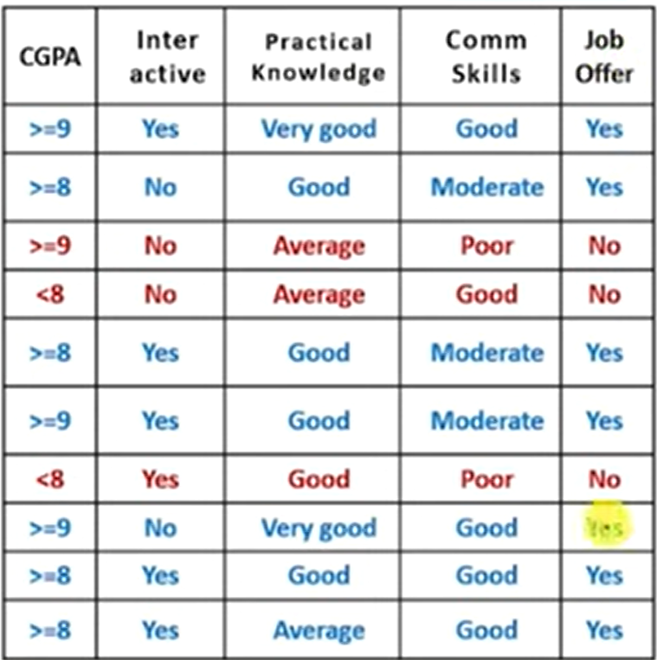
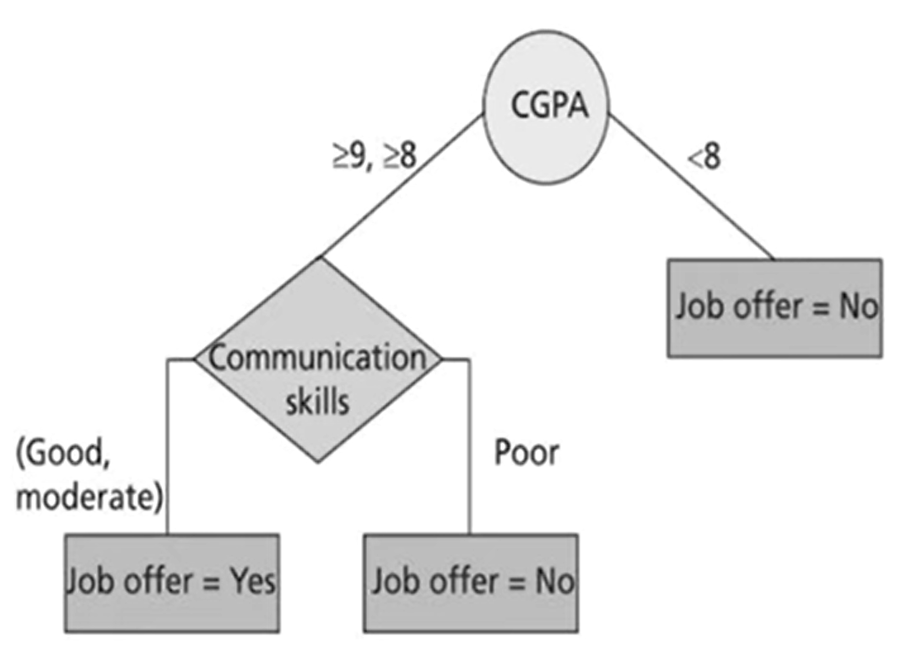
Case Study

Slide 30
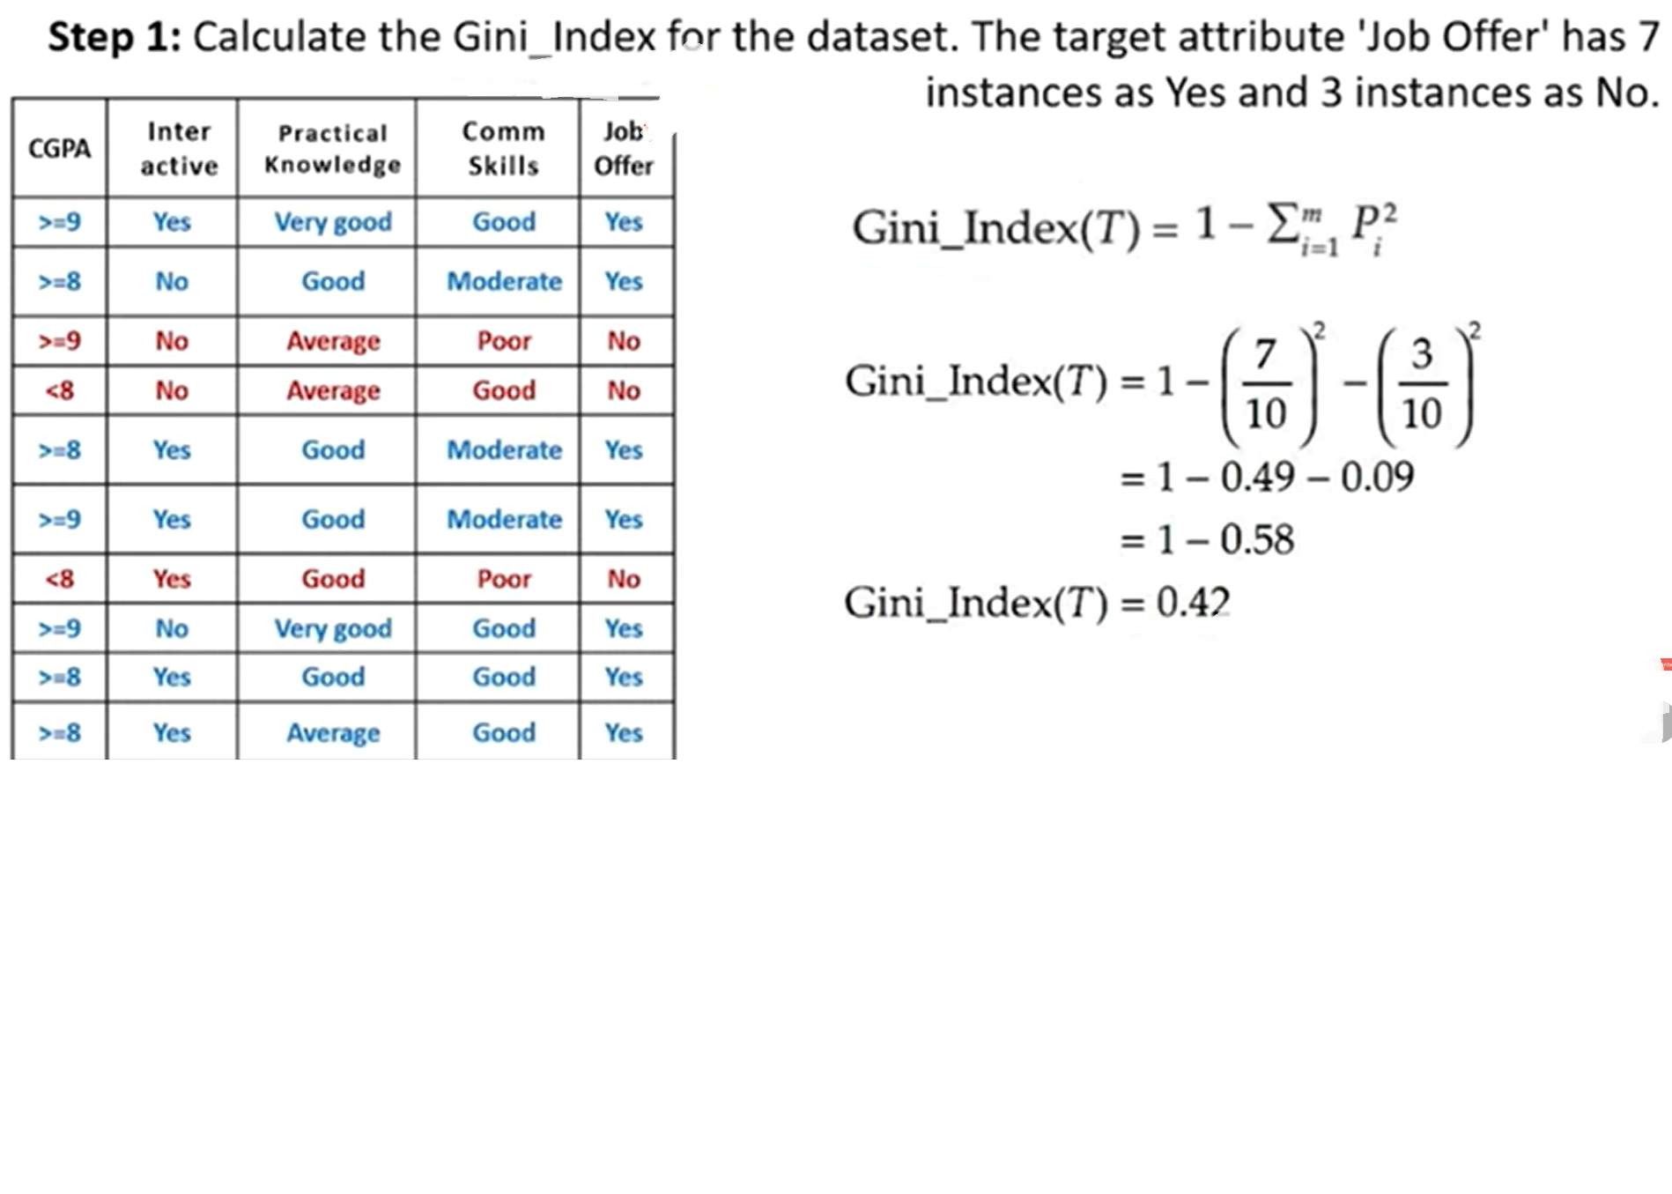

Slide 31
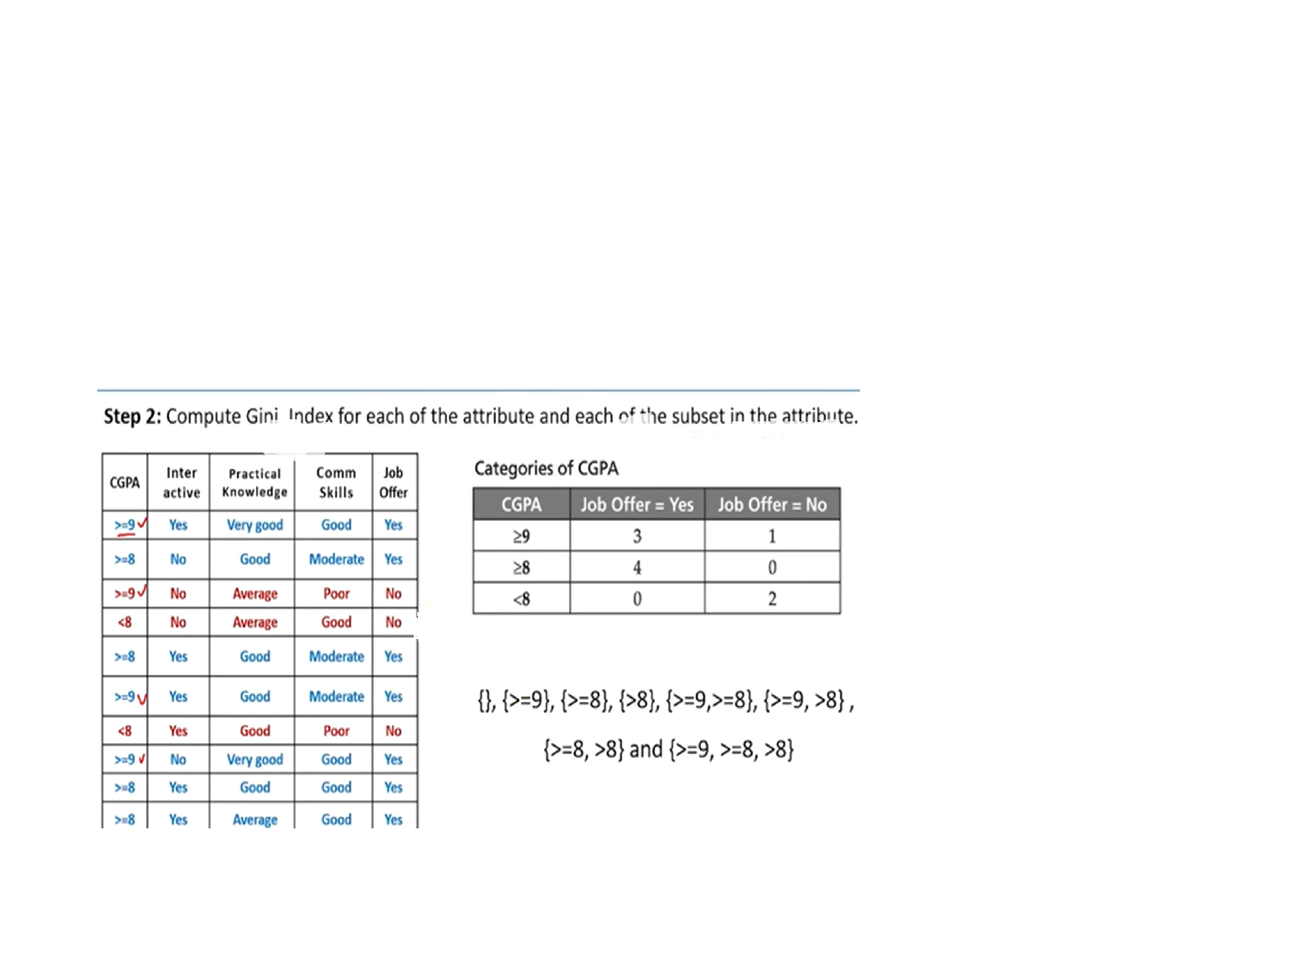

Slide 32
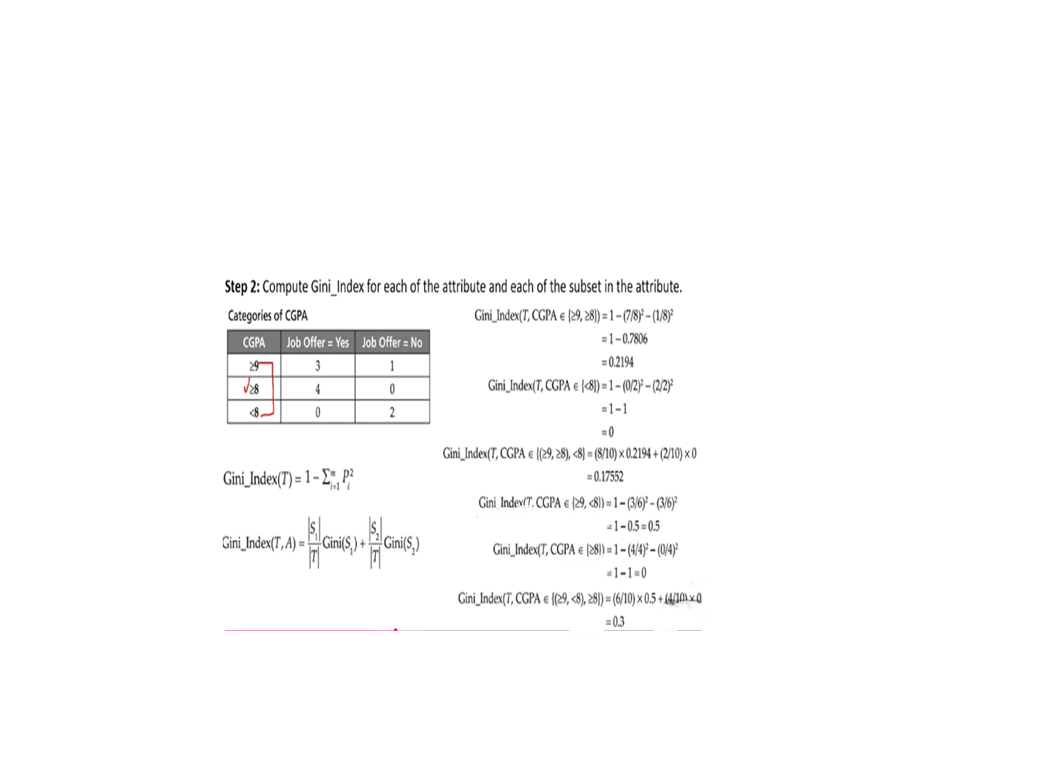

Slide 33
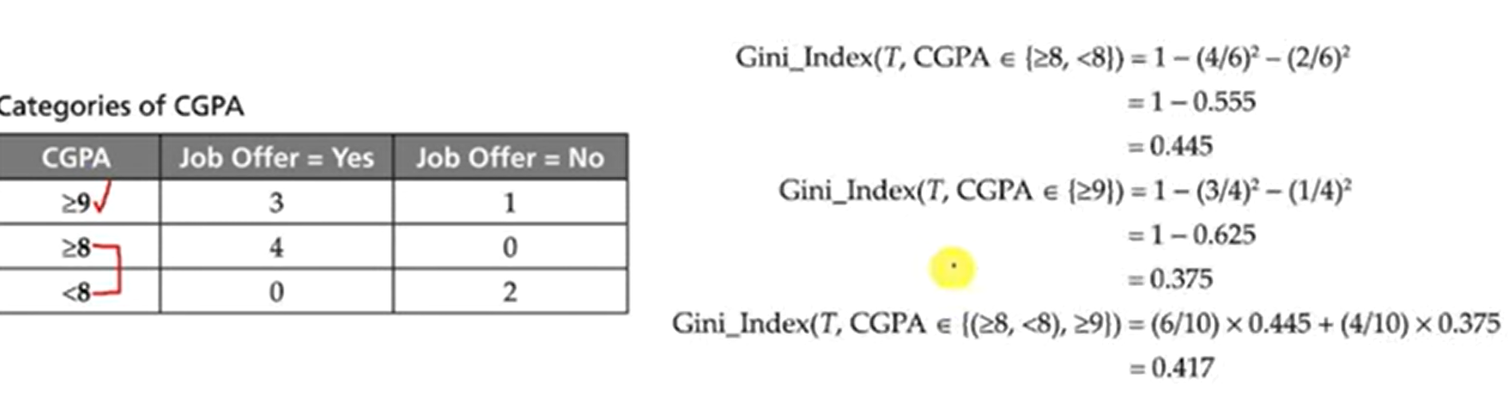

Slide 34
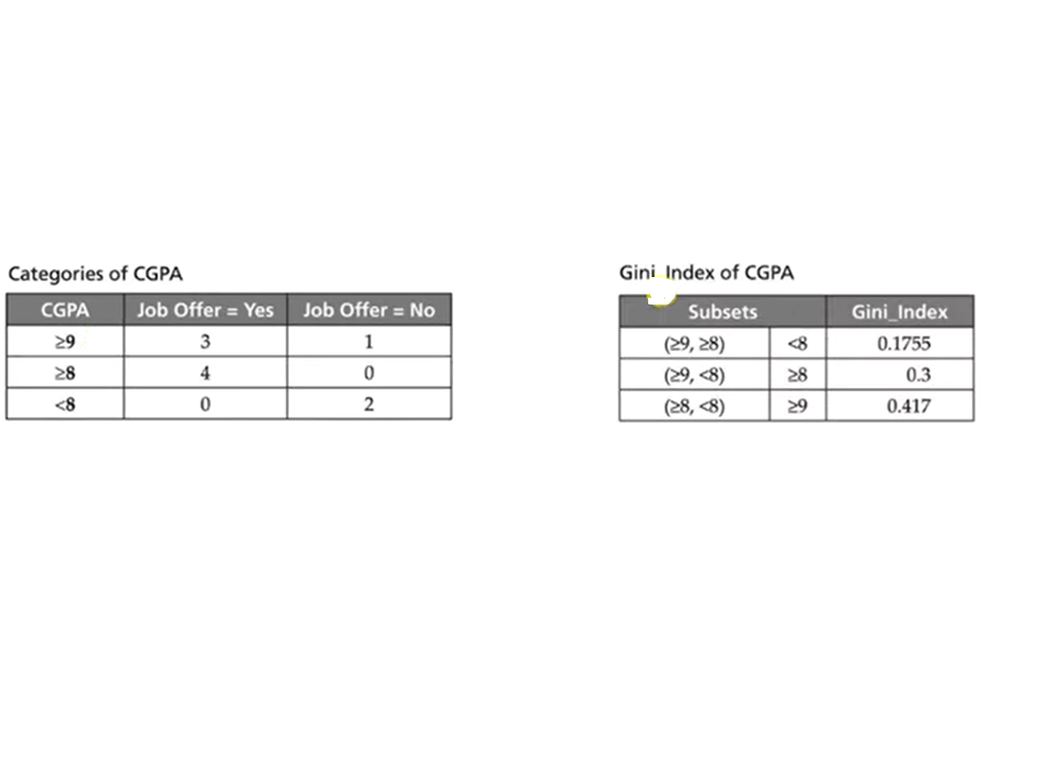
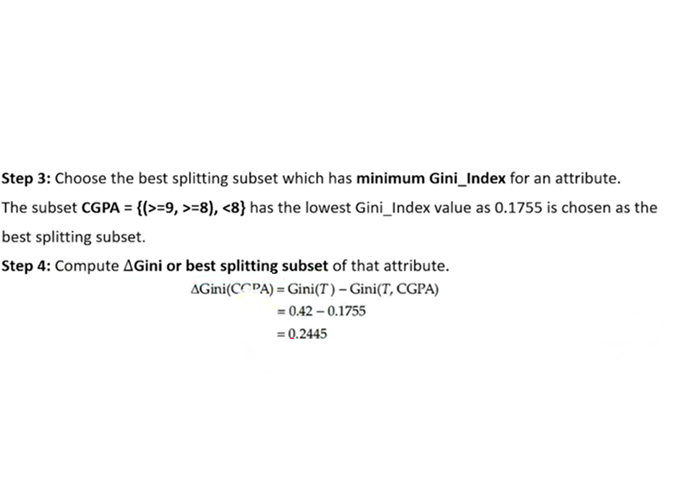

Slide 35
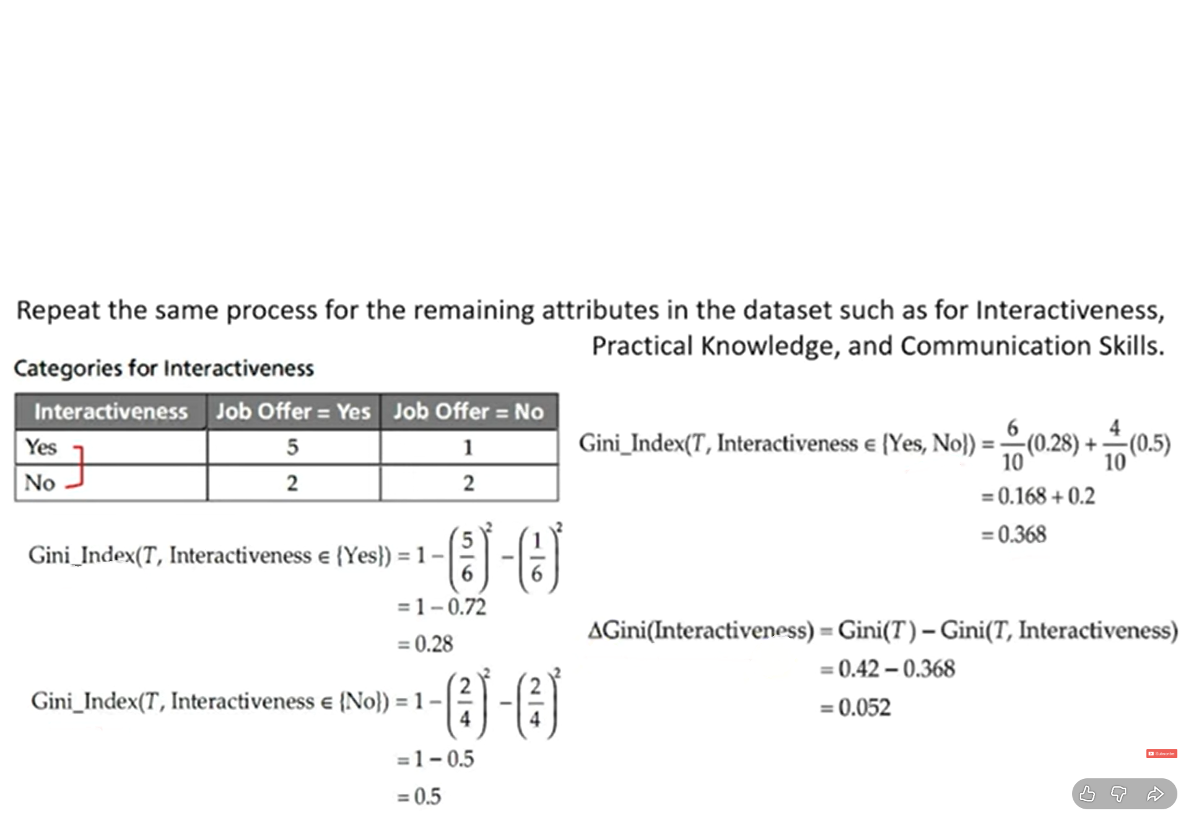

Slide 36
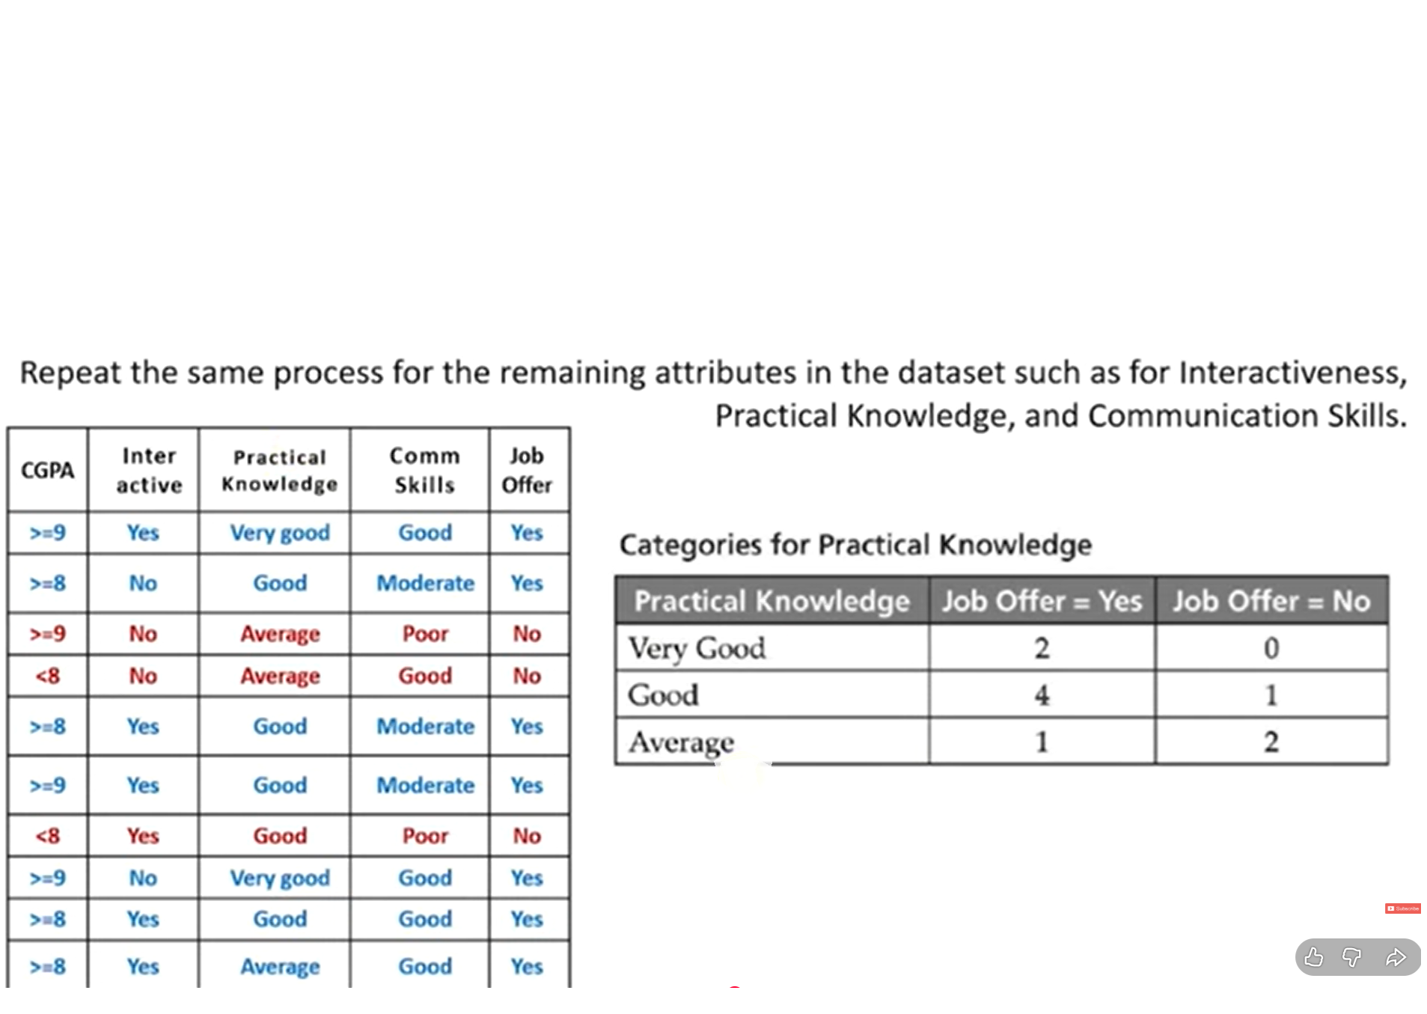

Slide 37
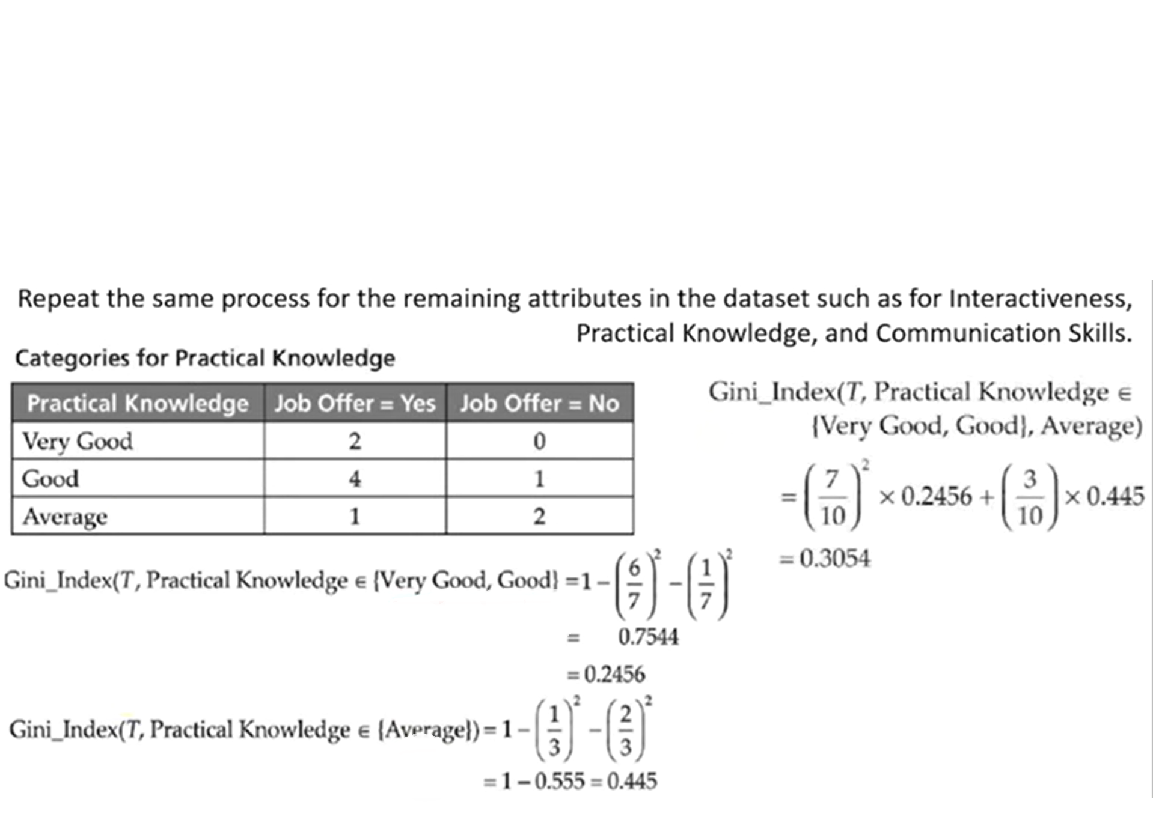

Slide 38
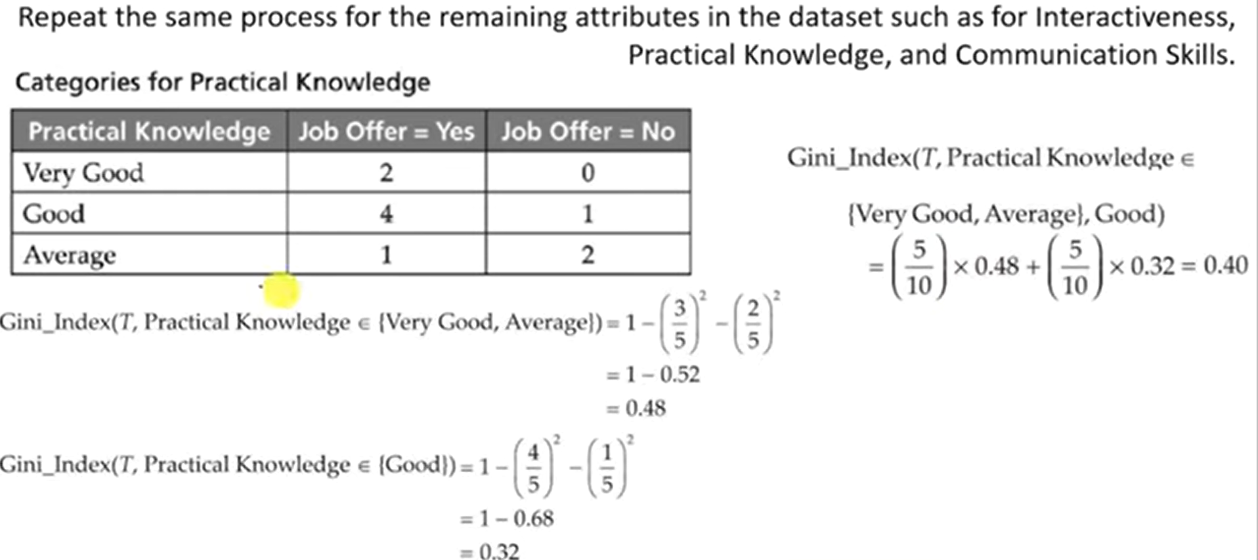

Slide 39
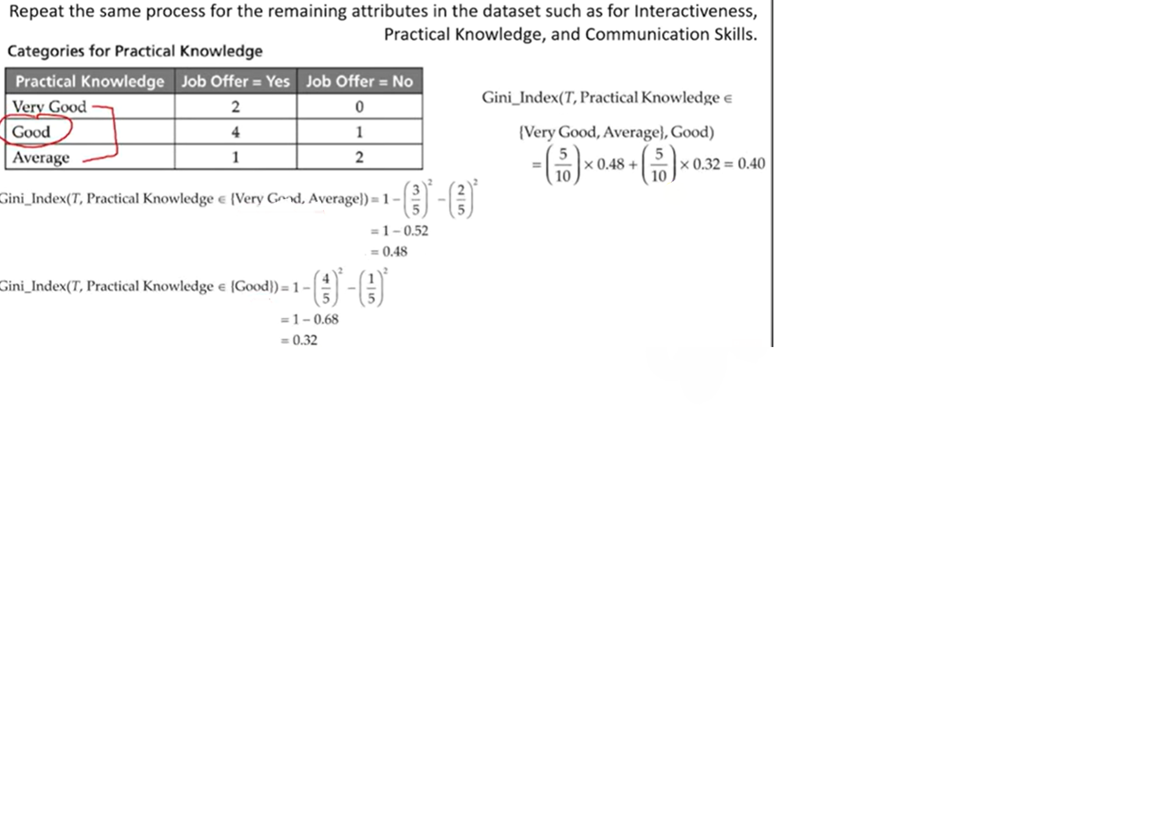

Slide 40
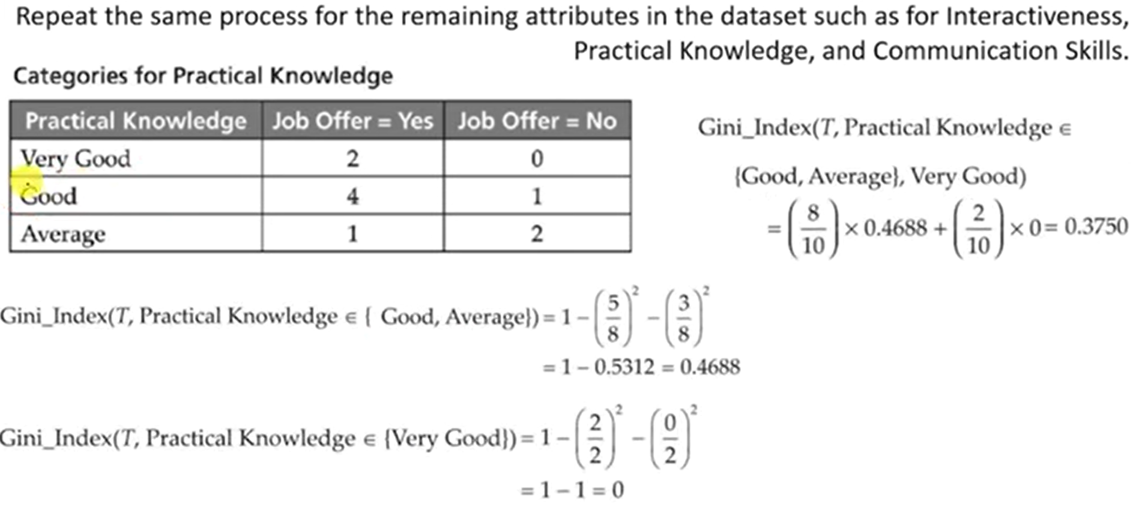

Slide 41
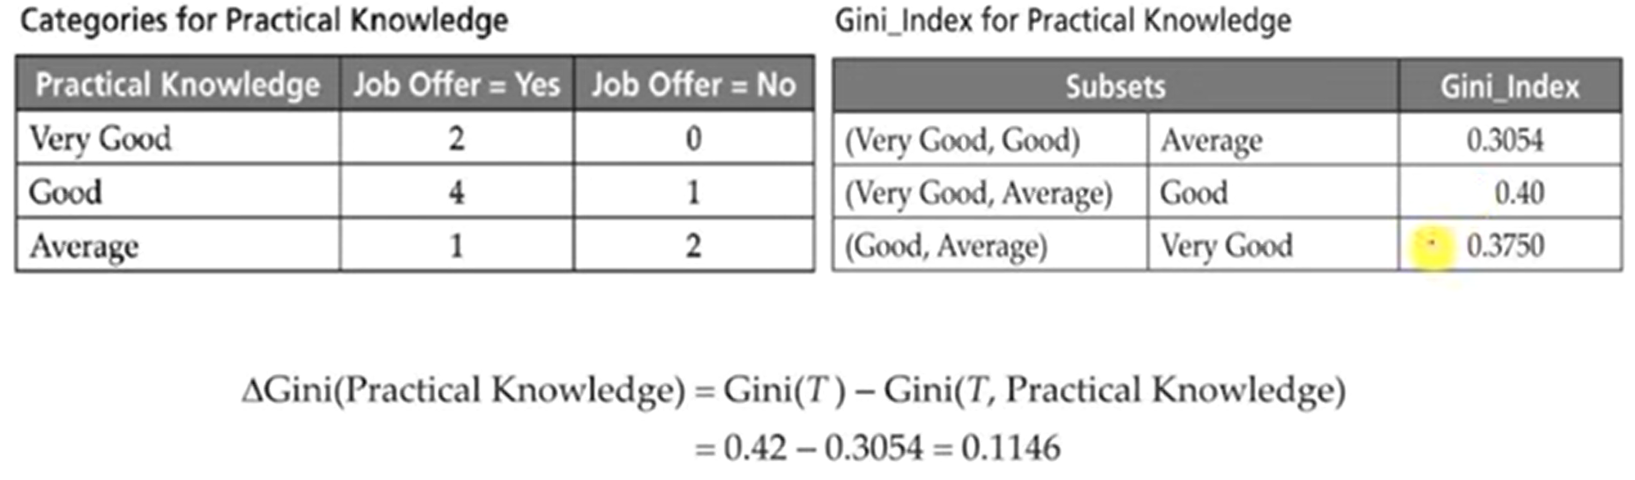

Slide 42
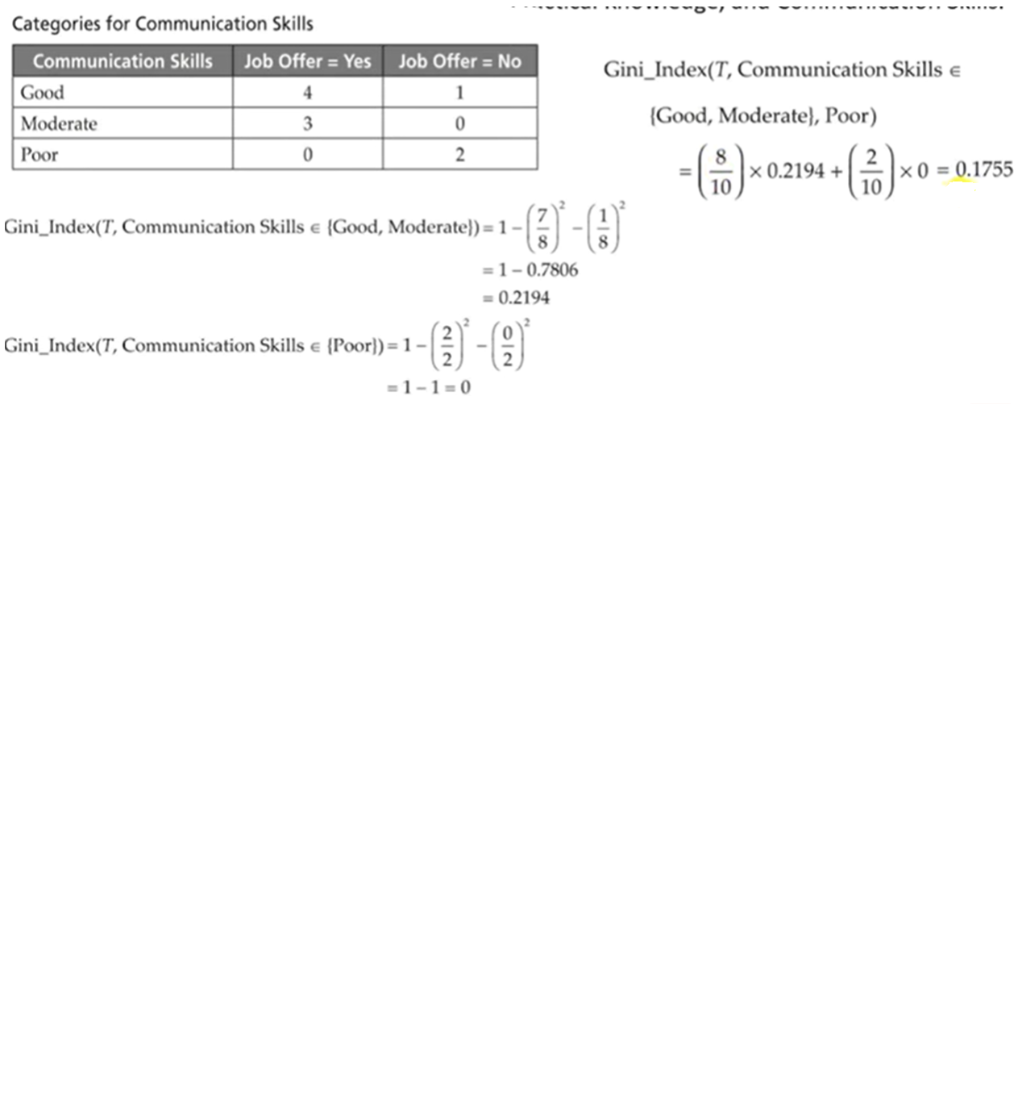

Slide 43
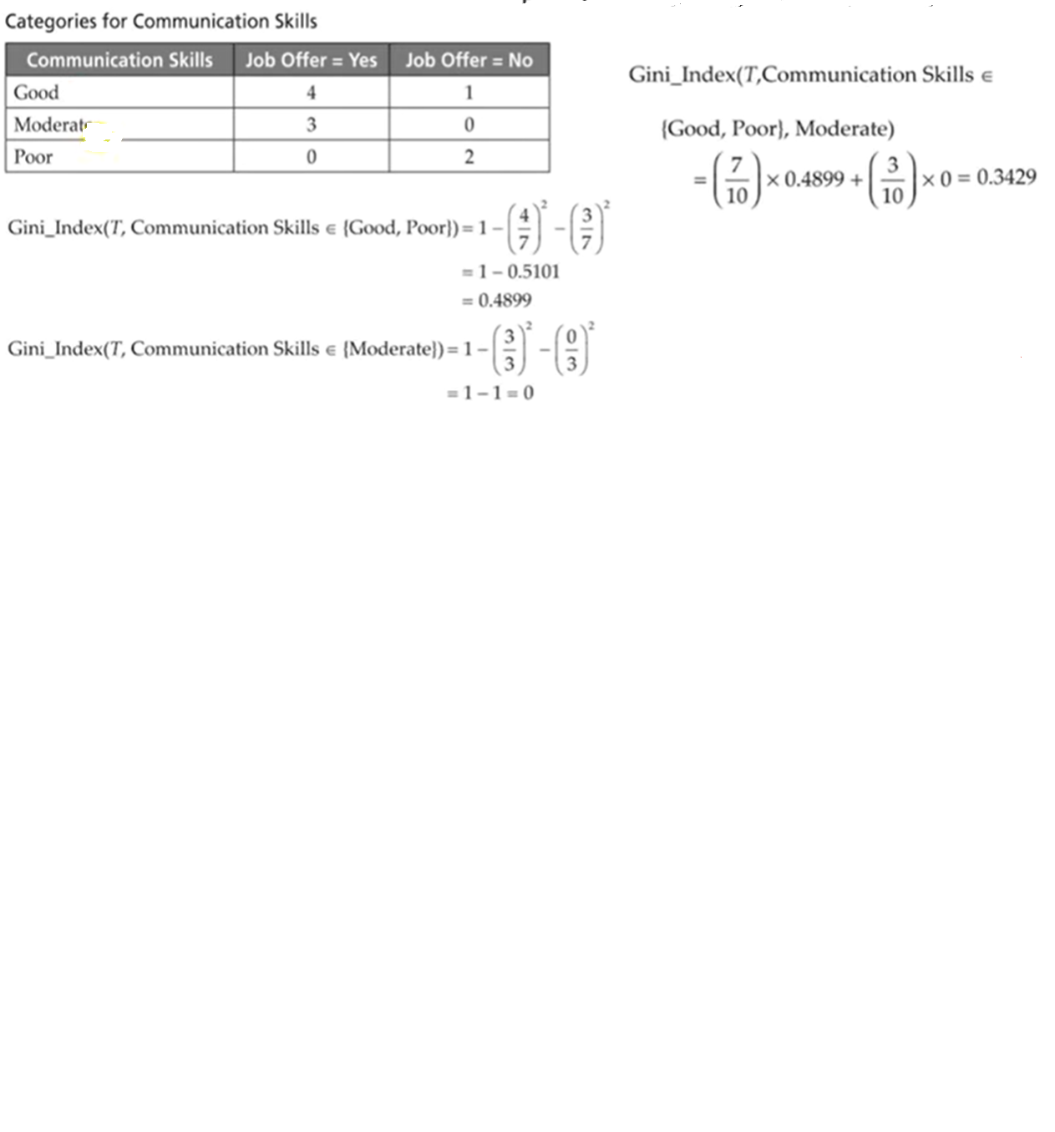

Slide 44
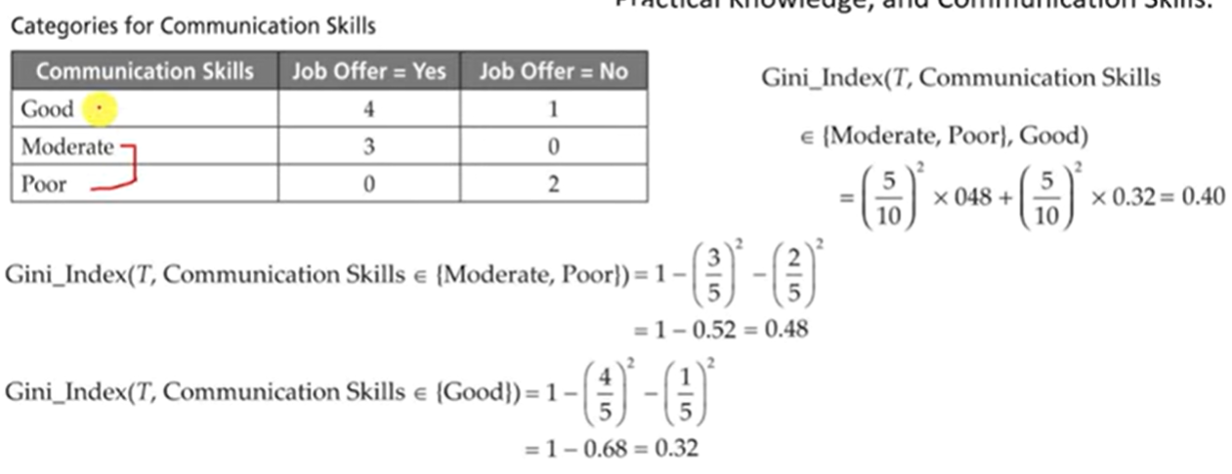

Slide 45
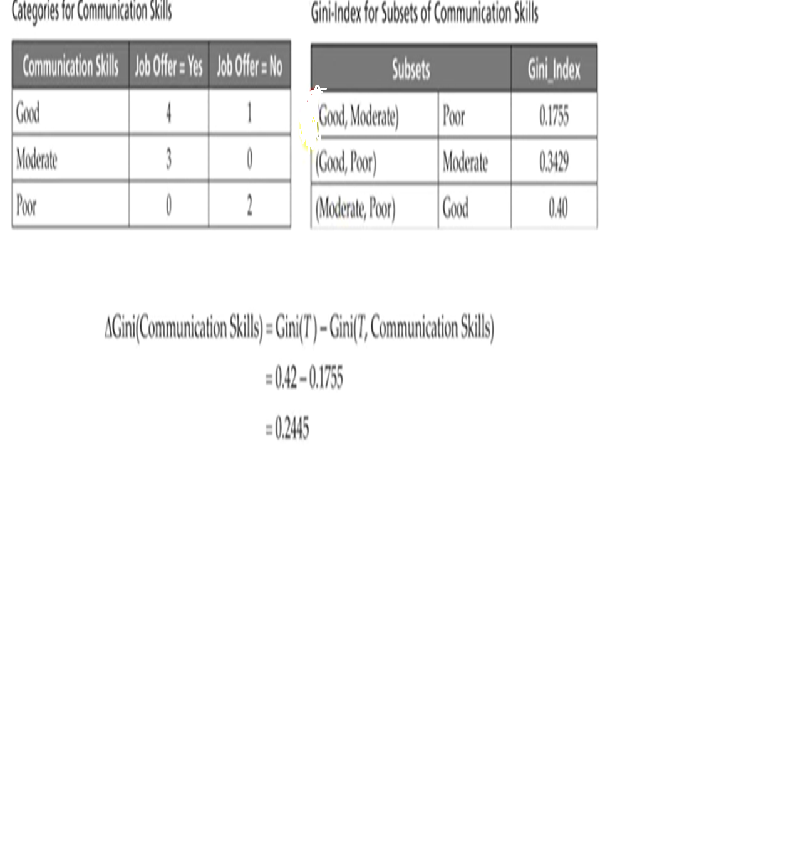

Slide 46
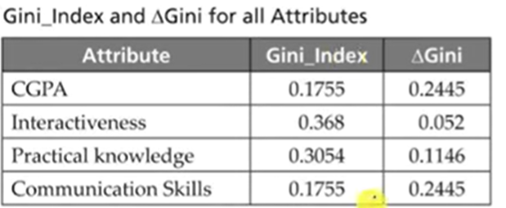
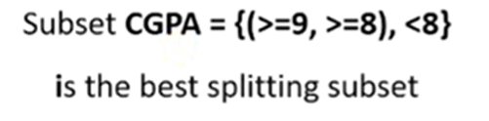

Slide 47
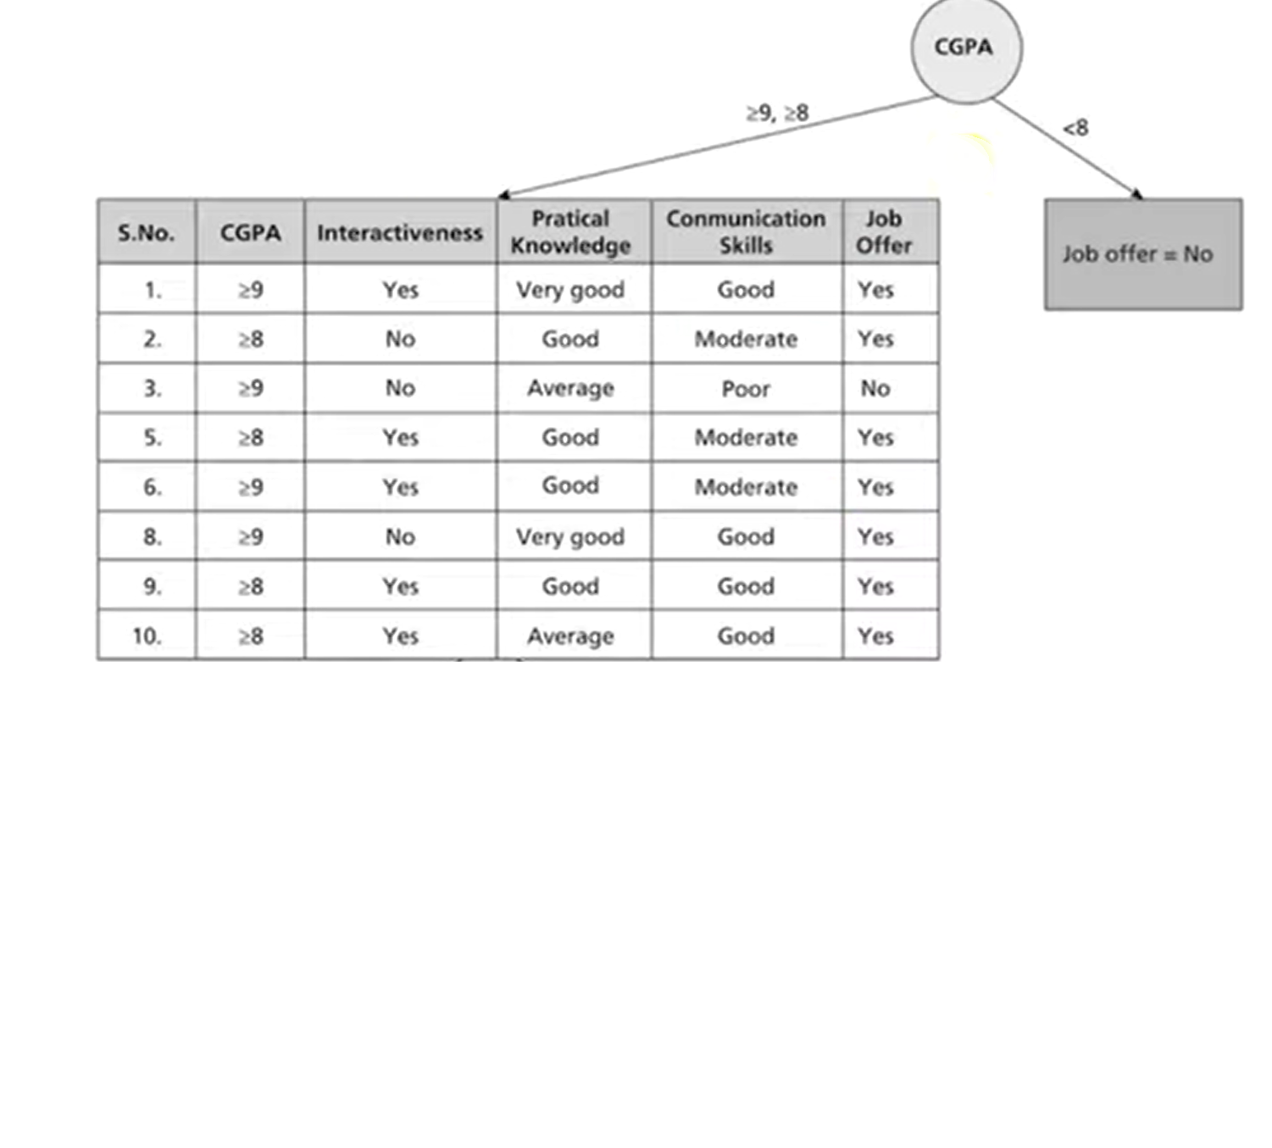

Slide 48
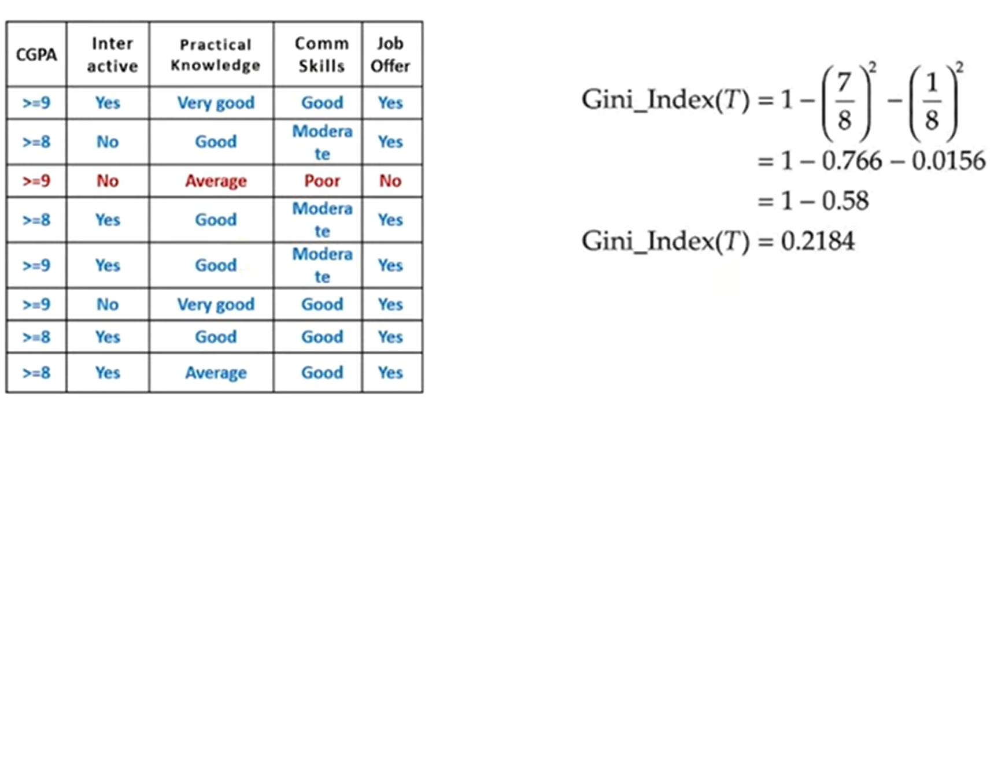

Slide 49
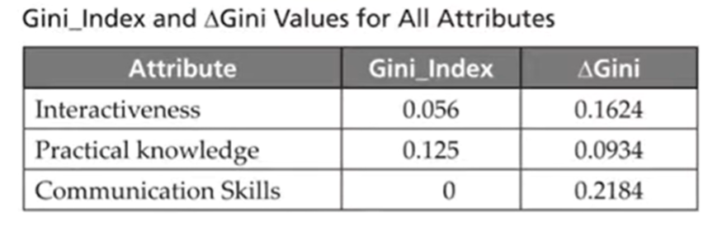

Slide 50
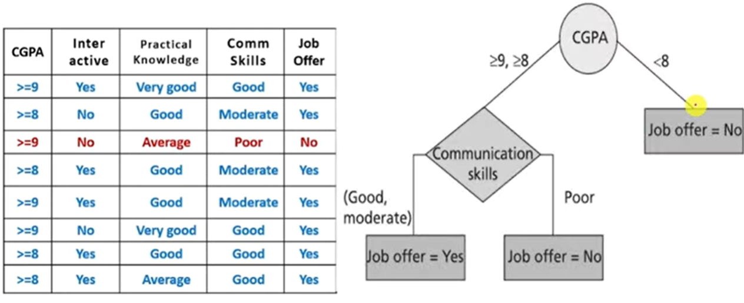

Slide 51
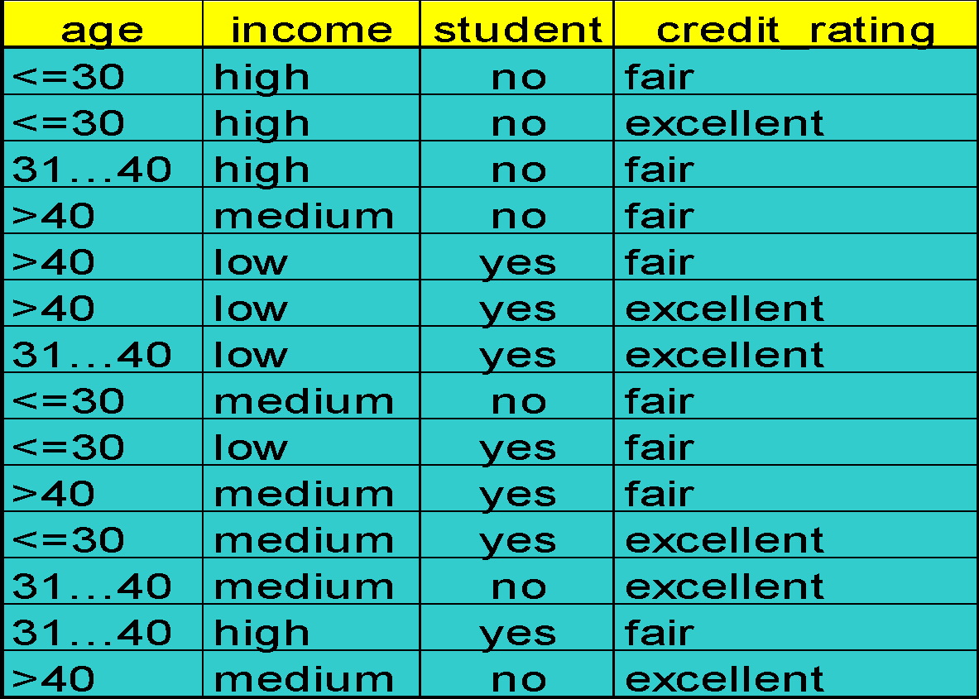
Training Dataset
This follows an example from Quinlan’s ID3
51

Slide 52
Output: A Decision Tree for “buys_computer”
age?
<=30
overcast
>40
30..40
student?
yes
credit rating?
no
yes
excellent
fair
no
yes
no
yes
52

Slide 53
Attribute Selection Measure
Information gain (ID3/C4.5)
All attributes are assumed to be categorical
Can be modified for continuous-valued attributes
Gini index (IBM IntelligentMiner)
All attributes are assumed continuous-valued
Assume there exist several possible split values for each attribute
May need other tools, such as clustering, to get the possible split values
Can be modified for categorical attributes
53

Slide 54
Ensembling Learning
Ensemble learning is a supervised learning algorithm
To improve overall performance by combining the predictions from multiple models
Meta algorithm which combine multiple ML techniques into one prediction model

Slide 55
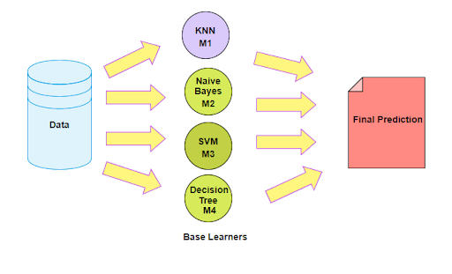

Slide 56
Ensembling Learning
Imagine you have the question of your life in front of you. Answering this question correctly will affect your life positively, otherwise negatively. But you're lucky: you can ask for advice from an expert of your choice, or you can ask an anonymous group, say 1,000 people, for advice. What advice would you get? The single expert opinion or the aggregated answer of an entire group of people? Or how about a group of experts?
Ensemble Learning is therefore used in the hope that a group of algorithms will produce a better result on average than a single algorithm could.

Slide 57
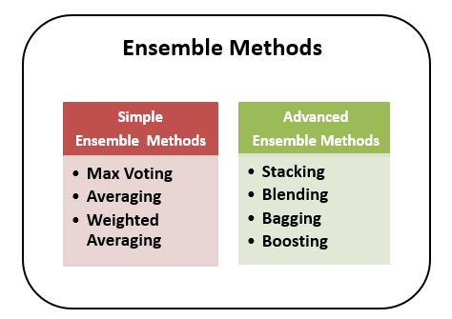
Types of Ensemble learning:

Slide 58
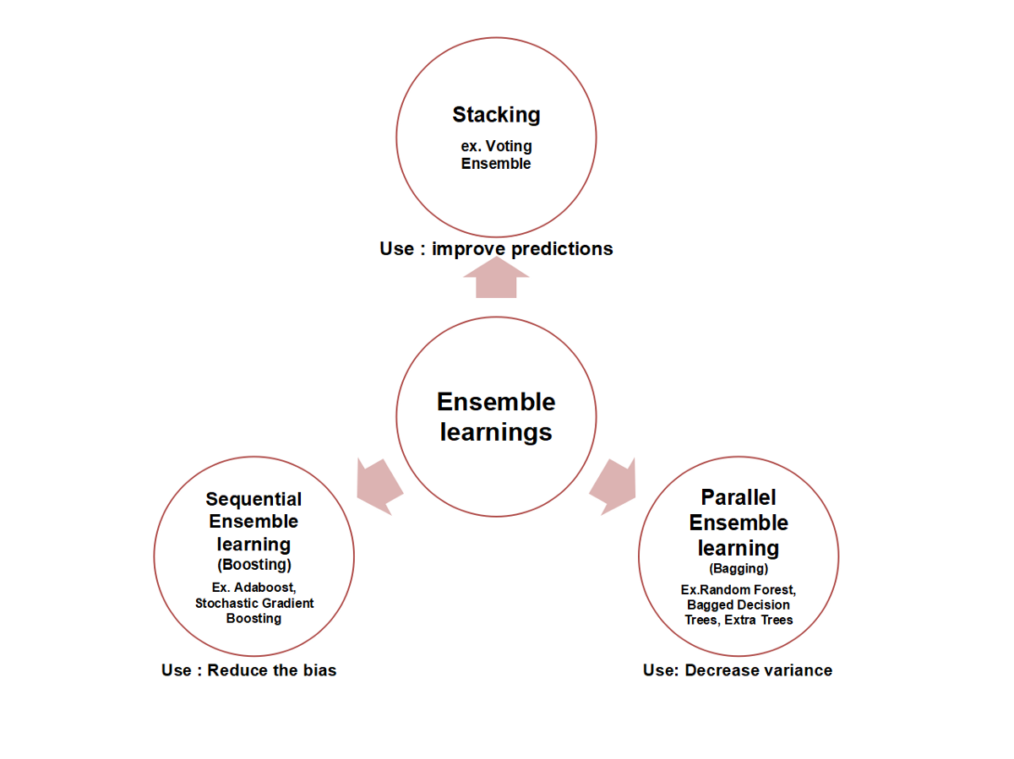
Ensembling Learning

Slide 59
Voting Classifier
A common form - and usually as the first example of an ensemble learner - is the principle of voting classifiers. The principle of voting classifiers is an extremely easy-to-understand idea of ​​ensemble learning and is therefore probably one of the best-known forms of collective mean formation.
A common question in data science is which classifier is better for certain purposes: decision trees, support vector machines, nearest neighbors or logistic regressions?
Why not just use them all? In fact, this is often practiced. The goal of this form of ensemble learning is easy to see: the different weaknesses of all algorithms should - so hope - cancel each other out. All algorithms (this may also refer to several identical algorithms with different parameters, e.g. several knN classifiers with different k values ​​and dimension weights) are trained for the same problem.

Slide 60
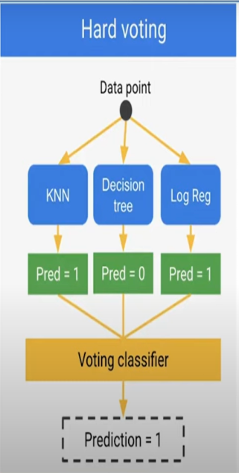
Voting is an ensemble machine learning algorithm that involves making a prediction that is the average(regression) or the sum (classification) of multiple machine learning models
First consider the multiple no. of the models, for each model is trained over the dataset

Slide 61
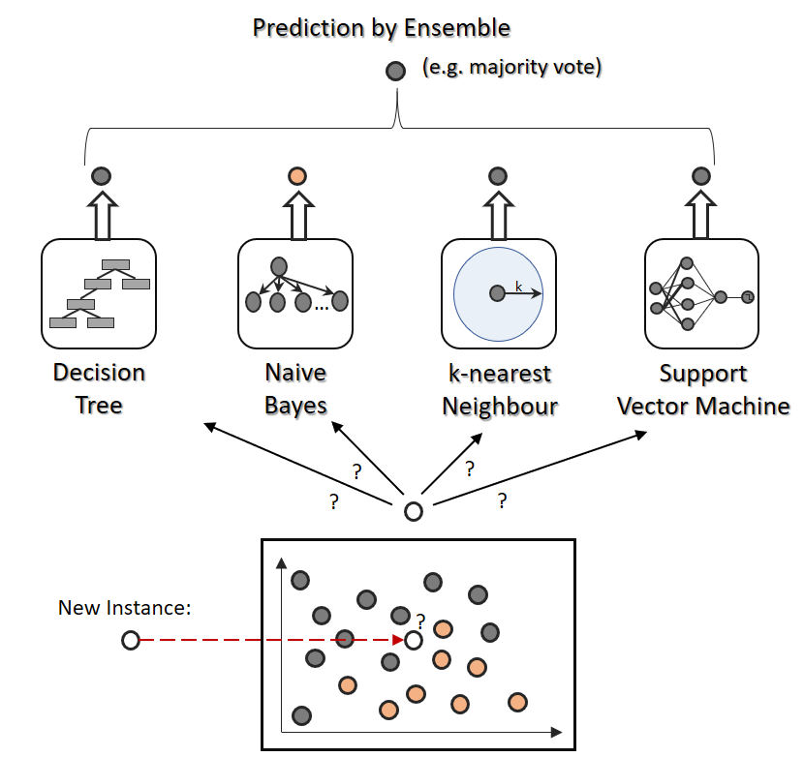

Slide 62
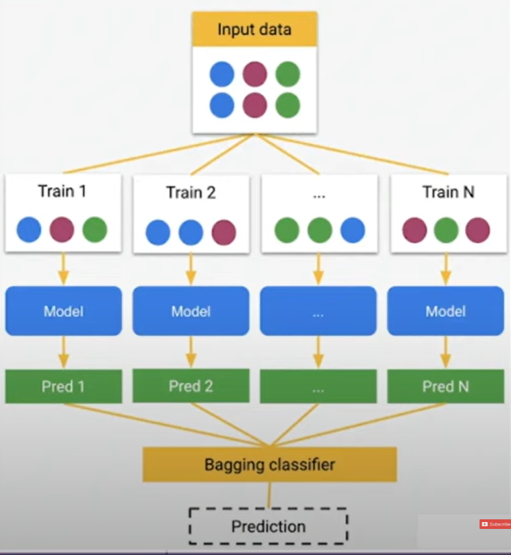
Bootstrap Aggregation (Bagging)
Bootstrap aggregation also known as bagging
Designed to improve stability and accuracy of machine learning algorithms like classification and regression
It decreases variance and helps to avoid overfitting
Usually applied to decision table tree methods

Slide 63
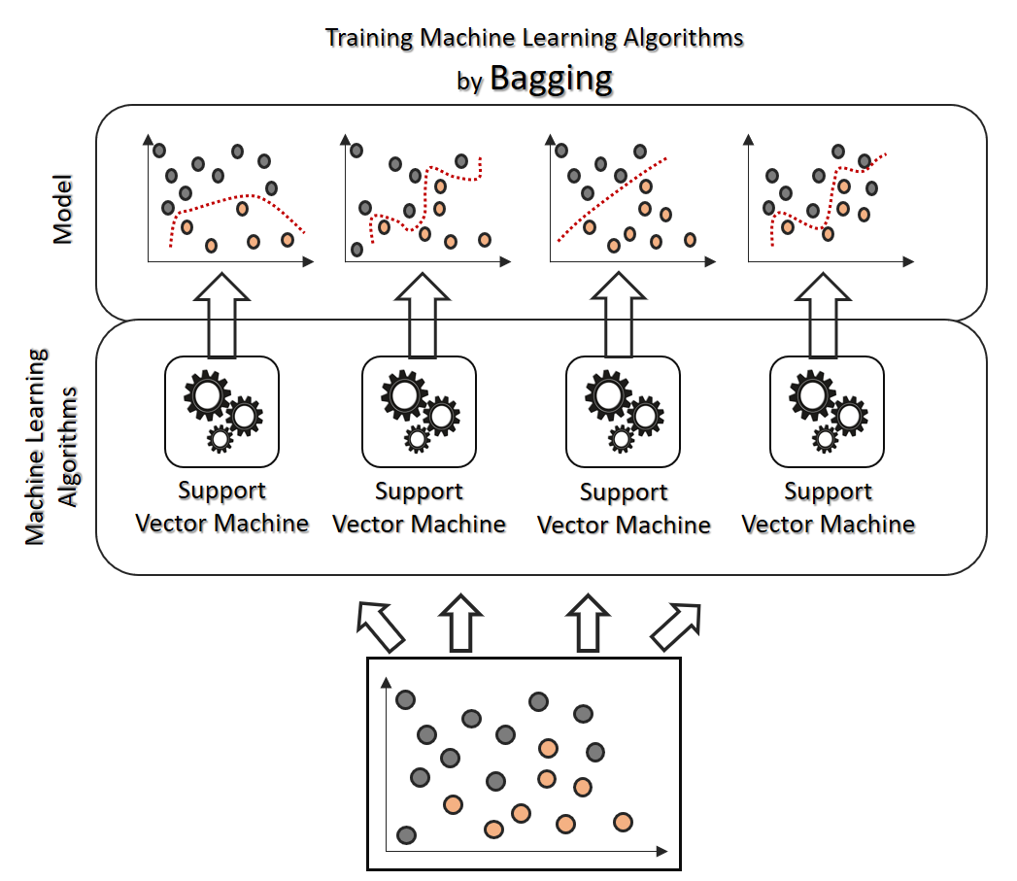

Slide 64
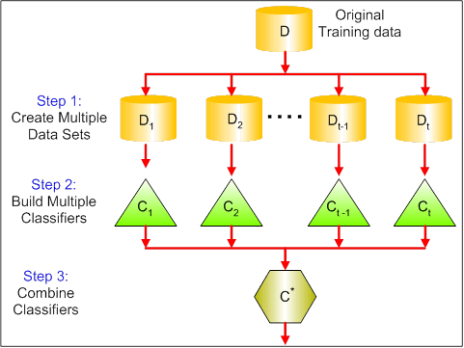
Bagging ( Bootstrap Aggregation)

Slide 65
Boosting
Boosting is an ensemble modeling technique that attempts to build a strong classifier from the no. of weak classifiers.
It is done by building a model by using weak models in series
Firstly, a model is built from the training data
Then, the second model is built which tries to correct the errors present in the first model
This procedure is continued and model are added until either the complete training data set is predicted correctly or the maximum number of models is added

Slide 66
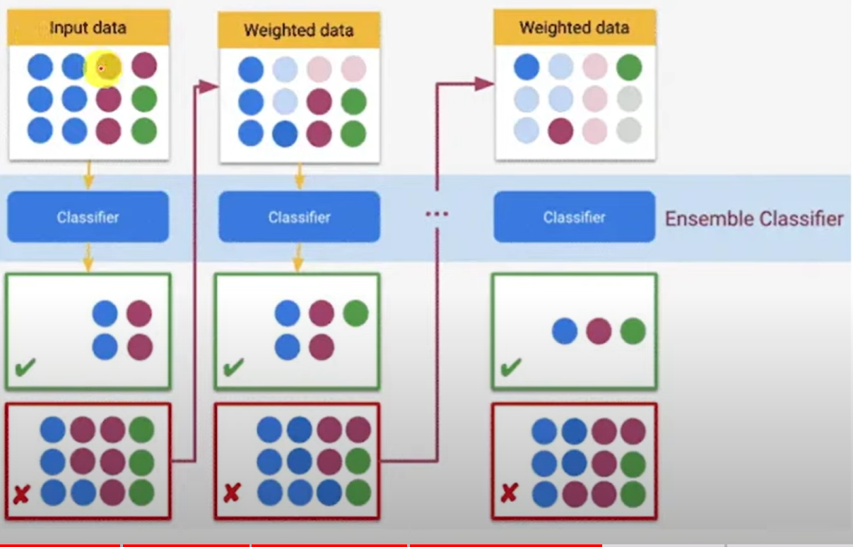

Slide 67
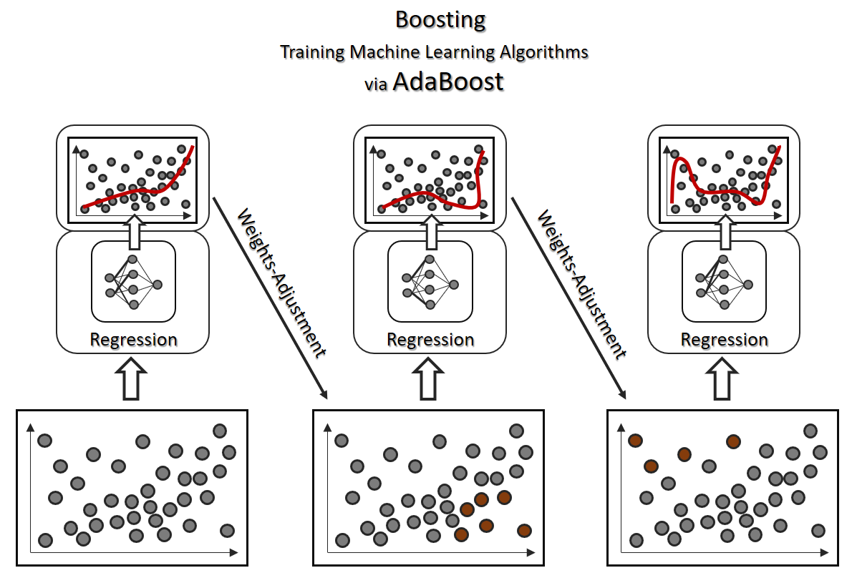
Boosting

Slide 68
Blending (Stacked Generalization)
Stacking, blending and stacked generalization are all the same thing with different names.
In traditional ensemble learning, we have multiple classifiers trying to fit to a training set to approximate the target function
Since each classifier will have its own output, we will need to find a combining mechanism to combine the results
This can be through voting (majority wins). weighted voting (some classifier has more authority than the others) , averaging the results etc…

Slide 69
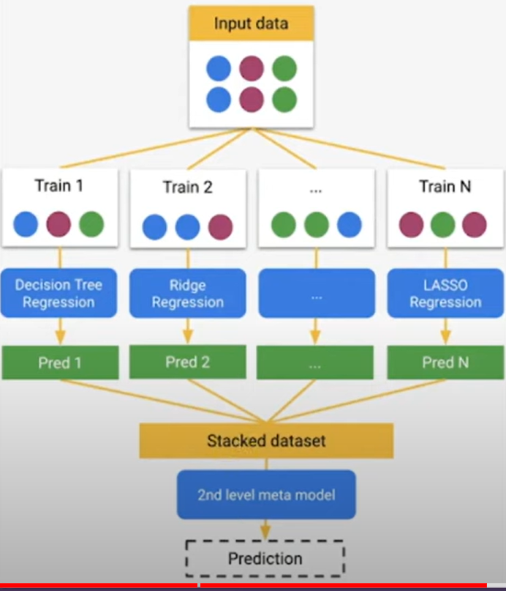
In stacking, the combining mechanism is that the output of the classifiers (Level 0) will be used as training data for another classifier (Level 1) to approximate the same target function
Basically, you let the level 1 classifier to figure out the combining mechanism

Slide 70
Basic Statistics
Averages
1)Mean
2)Median
3)Mode
Variance and Covariance
Bias
Gaussian Function

Slide 71
1)Mean:
The "mean" is the average value of a dataset. It is calculated by adding up all the values in the dataset and dividing by the number of observations. The mean is a useful measure of central tendency because it is sensitive to outliers, meaning that extreme values can significantly affect the value of the mean.
In Python, we can calculate the mean using the NumPy library, which provides a function called mean().
2) Median
The "median" is the middle value in a dataset. It is calculated by arranging the values in the dataset in order and finding the value that lies in the middle. If there are an even number of values in the dataset, the median is the average of the two middle values.
The median is a useful measure of central tendency because it is not affected by outliers, meaning that extreme values do not significantly affect the value of the median.
In Python, we can calculate the median using the NumPy library, which provides a function called median().

Slide 72
3)Mode:
The "mode" is the most common value in a dataset. It is calculated by finding the value that occurs most frequently in the dataset. If there are multiple values that occur with the same frequency, the dataset is said to be bimodal, trimodal, or multimodal.
The mode is a useful measure of central tendency because it can identify the most common value in a dataset. However, it is not a good measure of central tendency for datasets with a wide range of values or datasets with no repeating values.
In Python, we can calculate the mode using the SciPy library, which provides a function called mode().

Slide 73



Slide 74
Bias and Variance:
Machine learning is a branch of Artificial Intelligence, which allows machines to perform data analysis and make predictions. However, if the machine learning model is not accurate, it can make predictions errors, and these prediction errors are usually known as Bias and Variance.
The main aim of ML/data science analysts is to reduce these errors in order to get more accurate results.
Bias:
In general, a machine learning model analyses the data, find patterns in it and make predictions. While training, the model learns these patterns in the dataset and applies them to test data for prediction. While making predictions, a difference occurs between prediction values made by the model and actual values/expected values, and this difference is known as bias errors or Errors due to bias
Our model will not be trained well with the training data. there will be high training error when we train our model with the data

Slide 75
Variance :
The variance would specify the amount of variation in the prediction if the different training data was used. In simple words, variance tells that how much a random variable is different from its expected value.
If you train your data on training data and obtain a very low error, upon changing the data and then training the same previous model you experience high error. This is variance.
Variance errors are either of low variance or high variance.
Low variance means there is a small variation in the prediction of the target function with changes in the training data set. At the same time.
High variance shows a large variation in the prediction of the target function with changes in the training dataset.

Slide 76


Slide 77


Slide 78


Gaussian Function
Also called as normal distribution/ Bell Curve
If our machine learning models follows gaussian distribution, then it could predict outputs correctly with high accuracy.
Probability density function
Bell curve

Slide 79
K-Nearest Neighbor(KNN) Algorithm
K-Nearest Neighbour is one of the simplest Machine Learning algorithms based on Supervised Learning technique.
K-NN algorithm assumes the similarity between the new case/data and available cases and put the new case into the category that is most similar to the available categories.
K-NN algorithm stores all the available data and classifies a new data point based on the similarity. This means when new data appears then it can be easily classified into a well suite category by using K- NN algorithm.
K-NN algorithm can be used for Regression as well as for Classification but mostly it is used for the Classification problems.

Slide 80
K-Nearest Neighbor(KNN) Algorithm
KNN algorithm at the training phase just stores the dataset and when it gets new data, then it classifies that data into a category that is much similar to the new data
This requires computing the distance to each datapoint in the training set, which is relatively expensive: if we are in normal Euclidean space, then
we have to compute d subtractions and d squarings and this has to be done O(N2) times.
We can then identify the k nearest neighbours to the test point, and
then set the class of the test point to be the most common one out of those for the nearest neighbours.

Slide 81

Steps:

Slide 82
Step 1: Selecting the optimal value of K
K represents the number of nearest neighbors that needs to be considered while making prediction.
Step 2: Calculating distance
To measure the similarity between target and training data points, Euclidean distance is used. Distance is calculated between each of the data points in the dataset and target point.
Step 3: Finding Nearest Neighbors
The k data points with the smallest distances to the target point are the nearest neighbors.
Step 4: Voting for Classification or Taking Average for Regression
In the classification problem, the class labels of are determined by performing majority voting. The class with the most occurrences among the neighbors becomes the predicted class for the target data point.

Slide 83

In the regression problem, the class label is calculated by taking average of the target values of K nearest neighbors. The calculated average value becomes the predicted output for the target data point.
The algorithm calculates the distance between x and each data point in X using a distance metric, such as Euclidean distance:
(or)
Nearest neighbour methods are sensitive to noise, too large and the accuracy reduces as points that are too far away are considered. Some possible effects of changing the size of k on the decision boundary.

Slide 84

The k-nearest neighbours algorithm the bias-variance decomposition can be computed as:

Slide 85
Unsupervised Learning
The aim of unsupervised learning is to find clusters of similar inputs in the data without being explicitly told that these data points belong to one class and those to a different class. Instead, the algorithm has to discover the similarities for itself.

Slide 86
K-Means Clustering Algorithm
K-Means Clustering is an unsupervised learning algorithm that is used to solve the clustering problems
K-Means Clustering is an Unsupervised Learning algorithm, which groups the unlabeled dataset into different clusters. Here K defines the number of pre-defined clusters that need to be created in the process, as if K=2, there will be two clusters, and for K=3, there will be three clusters, and so on.
It allows us to cluster the data into different groups and a convenient way to discover the categories of groups in the unlabeled dataset on its own without the need for any training.
It is a centroid-based algorithm, where each cluster is associated with a centroid. The main aim of this algorithm is to minimize the sum of distances between the data point and their corresponding clusters.
The algorithm takes the unlabeled dataset as input, divides the dataset into k-number of clusters, and repeats the process until it does not find the best clusters. The value of k should be predetermined in this algorithm.

Slide 87


Slide 88


Slide 89
steps:
Step-1: Select the number K to decide the number of clusters.
Step-2: Select random K points or centroids. (It can be other from the input dataset).
Step-3: Assign each data point to their closest centroid, which will form the predefined K clusters.
Step-4: Calculate the variance and place a new centroid of each cluster.
Step-5: Repeat the third steps, which means reassign each datapoint to the new closest centroid of each cluster.
Step-6: If any reassignment occurs, then go to step-4 else go to FINISH.
Step-7: The model is ready.

Slide 90

Example:

Slide 91


Slide 92



Slide 93

Assign the data points to particular cluster, which is having smallest value

Slide 94


Calculate the new centroid, update the initial centroid with new centroid.

Slide 95

Again calculate the distance between the data points and assign to cluster

Slide 96

Calculate new centroids

Slide 97


In the above table, B1 point moved from cluster 2 to 1 so need to calculate the new centroid

Slide 98


